Slide 1
My Applications Interactive Notebook
Name
Class AEMAA 1
Teacher Mrs Keen
Term 1 Semester 1
1

Slide 2
Create your own front page
It needs to contain the following –
My applications interactive notebook
Name
Class
Teachers Name
Semester 1 Term 1
Page number 1

Slide 3
Contents
Glossary or Formula Page
Page
Date
Description
2
3

Slide 4
Tasks
24
7
30
Essential Question
Questions
Notes
Summary
4
5

Slide 5
24
7
30
Date
Topic
Simple Interest
EQ – How do I calculate simple interest?

Slide 6
24
7
30
Date
Topic
Simple Interest
EQ – How do I calculate simple interest?
Formula using % as a decimal
e.g. 10% = 0.1

Slide 7
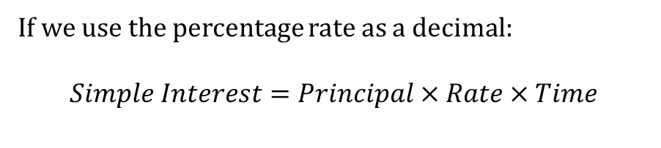
24
7
30
Date
Topic
Simple Interest
EQ – How do I calculate simple interest?
Formula using % as a decimal
e.g. 10% = 0.1
If we use the percentage rate as a decimal:
$$Simple Interest=Principal×Rate×Time$$

Slide 8
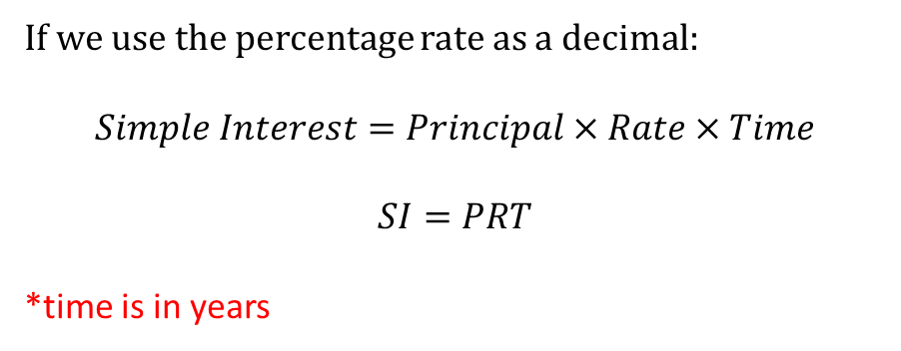
24
7
30
Date
Topic
Simple Interest
EQ – How do I calculate simple interest?
Formula using % as a decimal
e.g. 10% = 0.1
If we use the percentage rate as a decimal:
$$Simple Interest=Principal×Rate×Time$$
$$SI=PRT$$
*time is in years

Slide 9
24
7
30
Date
Topic
Simple Interest
EQ – How do I calculate simple interest?
Formula using % as a decimal
e.g. 10% = 0.1
If we use the percentage rate as a decimal:
$$Simple Interest=Principal×Rate×Time$$
$$SI=PRT$$
*time is in years
e.g. Determine the interest paid on $8 400 invested at 2.4% per annum simple interest for 5 years.

Slide 10
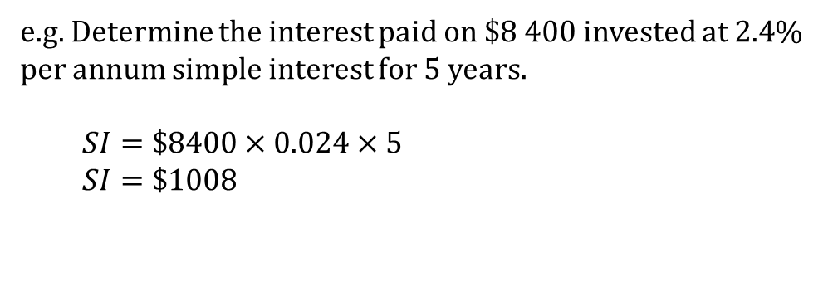
24
7
30
Date
Topic
Simple Interest
EQ – How do I calculate simple interest?
Formula using % as a decimal
e.g. 10% = 0.1
If we use the percentage rate as a decimal:
$$Simple Interest=Principal×Rate×Time$$
$$SI=PRT$$
*time is in years
e.g. Determine the interest paid on $8 400 invested at 2.4% per annum simple interest for 5 years.
$$SI=\$8400×0.024×5$$
$$SI=\$1008$$

Slide 11
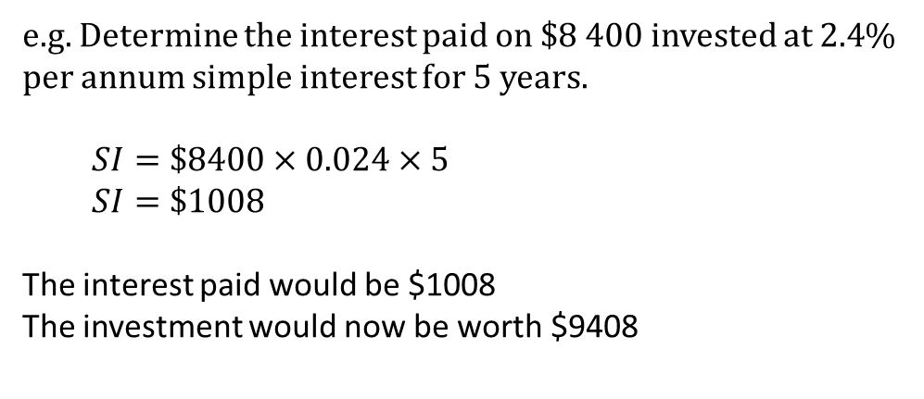
24
7
30
Date
Topic
Simple Interest
EQ – How do I calculate simple interest?
Formula using % as a decimal
e.g. 10% = 0.1
If we use the percentage rate as a decimal:
$$Simple Interest=Principal×Rate×Time$$
$$SI=PRT$$
*time is in years
e.g. Determine the interest paid on $8 400 invested at 2.4% per annum simple interest for 5 years.
$$SI=\$8400×0.024×5$$
$$SI=\$1008$$
The interest paid would be $1008
The investment would now be worth $9408

Slide 12
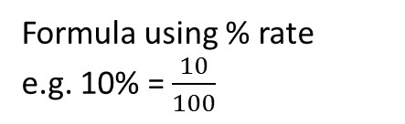
24
7
30
Date
Topic
Simple Interest
EQ – How do I calculate simple interest?
Formula using % rate
e.g. 10% = $\frac{10}{100}$

Slide 13
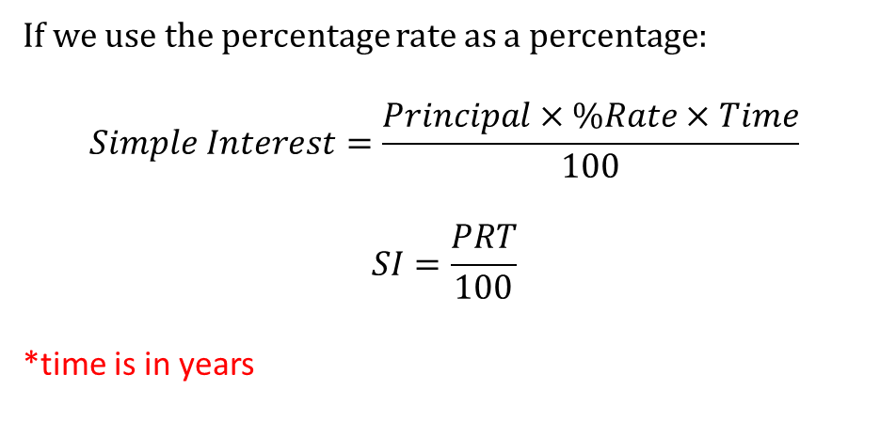
24
7
30
Date
Topic
Simple Interest
EQ – How do I calculate simple interest?
Formula using % rate
e.g. 10% = $\frac{10}{100}$
If we use the percentage rate as a percentage:
$$Simple Interest=\frac{Principal×\%Rate×Time}{100}$$
$$SI=\frac{PRT}{100}$$
*time is in years

Slide 14
24
7
30
Date
Topic
Simple Interest
EQ – How do I calculate simple interest?
Formula using % rate
e.g. 10% = $\frac{10}{100}$
If we use the percentage rate as a percentage:
$$Simple Interest=\frac{Principal×\%Rate×Time}{100}$$
$$SI=\frac{PRT}{100}$$
*time is in years
e.g. Determine the interest paid on $8 400 invested at 2.4% per annum simple interest for 5 years.

Slide 15
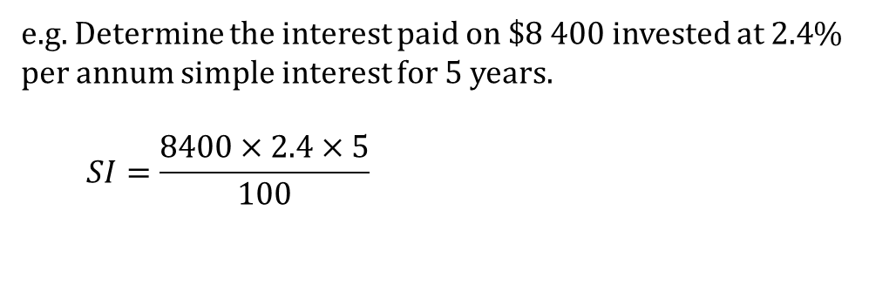
24
7
30
Date
Topic
Simple Interest
EQ – How do I calculate simple interest?
Formula using % rate
e.g. 10% = $\frac{10}{100}$
If we use the percentage rate as a percentage:
$$Simple Interest=\frac{Principal×\%Rate×Time}{100}$$
$$SI=\frac{PRT}{100}$$
*time is in years
e.g. Determine the interest paid on $8 400 invested at 2.4% per annum simple interest for 5 years.
$$SI=\frac{8400×2.4×5}{100}$$

Slide 16
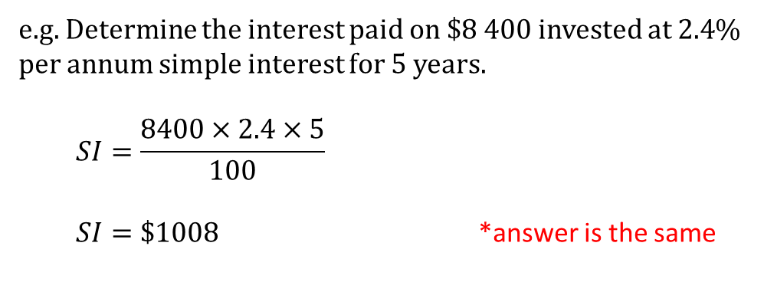
24
7
30
Date
Topic
Simple Interest
EQ – How do I calculate simple interest?
Formula using % rate
e.g. 10% = $\frac{10}{100}$
If we use the percentage rate as a percentage:
$$Simple Interest=\frac{Principal×\%Rate×Time}{100}$$
$$SI=\frac{PRT}{100}$$
*time is in years
e.g. Determine the interest paid on $8 400 invested at 2.4% per annum simple interest for 5 years.
$$SI=\frac{8400×2.4×5}{100}$$
$SI=\$1008$ *answer is the same

Slide 17
24
7
30
Date
Topic
Simple Interest
EQ – How do I calculate simple interest?
What is the investment is not in years but some other length of time?

Slide 18
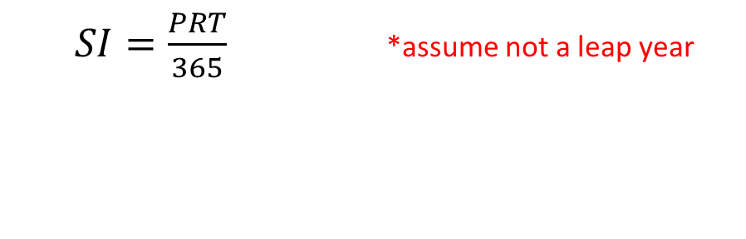
24
7
30
Date
Topic
Simple Interest
EQ – How do I calculate simple interest?
What is the investment is not in years but some other length of time?
Time in Days
$SI=\frac{PRT}{365}$ *assume not a leap year

Slide 19

24
7
30
Date
Topic
Simple Interest
EQ – How do I calculate simple interest?
What is the investment is not in years but some other length of time?
Time in Days
$SI=\frac{PRT}{365}$ *assume not a leap year
$SI=\frac{PRT}{12}$
Time in Months

Slide 20

24
7
30
Date
Topic
Simple Interest
EQ – How do I calculate simple interest?
What is the investment is not in years but some other length of time?
Time in Days
$SI=\frac{PRT}{365}$ *assume not a leap year
$SI=\frac{PRT}{12}$
$$SI=\frac{PRT}{4}$$
Time in Months
Time in quarters

Slide 21

24
7
30
Date
Topic
Simple Interest
EQ – How do I calculate simple interest?
What is the investment is not in years but some other length of time?
Time in Days
$SI=\frac{PRT}{365}$ *assume not a leap year
$SI=\frac{PRT}{12}$
$$SI=\frac{PRT}{4}$$
$SI=\frac{PRT}{2}$
Time in Months
Time in quarters
Time as 6 monthly
(also called biannual)

Slide 22
Task
Complete questions 1-13 on pages 42 and 43.
Homework:
Complete questions on simple interest set for you on Mathspace.

Slide 23
Notes Review
24, 7 ,30
Date
Title
Essential question
Notes complete
Notes complete with colour and diagrams
Questions completed
Contents page filled in
Formula page filled in

Slide 24
Homework
Review your notes and write a summary answering the essential question.

